Slide 1
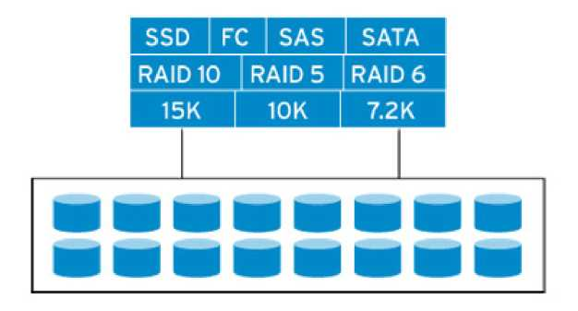
Storage Virtualization
1

Slide 2

1. Storage Interfaces: SCSI and Fibre Channel
2. Storage Area Networks
3. Storage Virtualization
1. Device Virtualization: RAID
2. F abric Virtualization: Storage access over Ethernet or IP
4. SAN vs. NAS
2

Slide 3
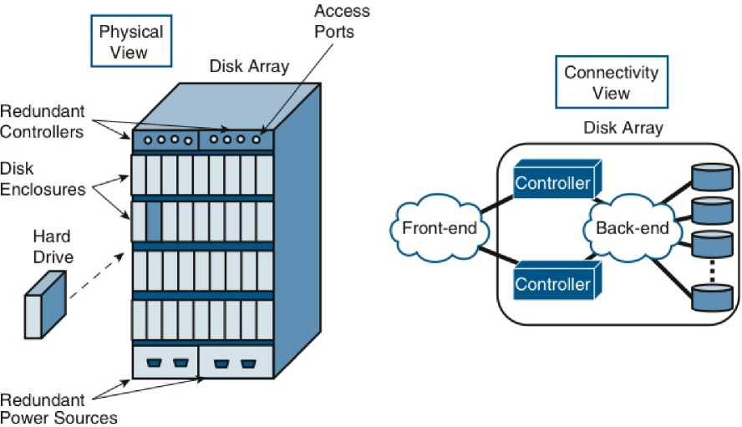
Disk Arrays
□ In data centers, all disks are external to the server
^Data accessible by other servers in case of a server failure
□ JBODs (Just a bunch of disks): Difficult to manage
□ Disk Arrays: An easy to manage pool of disks with redundancy
3

Slide 4
Data Access Methods
Three ways for applications to access data:
□ Block Access: A fixed number of bytes (block-size), e.g., 1 sector, 4 sectors, 16 sectors
□ File Access: A set of bytes with name, creation date, and other meta data.
> May or may not be contiguous.
> A file system, such as, FAT-32 (File Allocation Table) or NTFS (New Technology File System) defines how the meta-data is stored and files are organized.
> File systems vary with the operating systems.
□ Record Access: Used for highly structured data in databases.
Each record has a particular format and set of fields.
Accessed using Structured Query Language (SQL), Open DataBase Connectivity (ODBC), Java DataBase Connectivity (JDBC)
□ Storage systems provide block access. A logical volume manager in the OS provides other “virtual” views, e.g., file or record
4

Slide 5
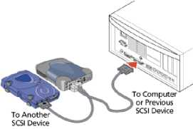
SCSI (Small Computer System Interface)
□ Used to connect disk drives and tapes to computer
□ 8-16 devices on a single bus. Any number of hosts on the bus
At least one host with host bus adapter (HBA)
□ Standard commands, protocols, and optical and electrical interfaces.
□ Peer-to-peer: host-to-device, device-to-device, host-to-host But most devices implement only targets. Can't be initiators.
□ Each device on the SCSI bus has a "ID".
□ Each device may consist of multiple logical units (LUNs). LUNS are like apartments in a building.
□ A direct access (disk) storage is addressed by a Logical Block Address (LBA). Each LB is typically 512 bytes.
□ Initially used a parallel interface (Parallel SCSI) ^ Skew Now Serial Attached SCSI (SAS) for higher speed
5

Slide 6
Advanced Technology Attachment (ATA)
□ Parallel Advanced Technology Attachment (PATA):
> Designed in 1986 for PCs. Controller integrated in the disk ^ Integrated Device Electronics (IDE).
> 133 Mbps using parallel ribbon cables
□ ATA Packet Interface (ATAPI): Extended PATA to CD-ROMS, DVD-ROMs, and Tape drives
□ Serial Advanced Technology Attachment (SATA):
> Designed in 2003 for internal hard disks. 6 Gbps.
□ PATA Enhancements: ATA-2 (Ultra ATA), ATA-3 (EIDE) SATA Enhancements: external SATA (eSATA), mini SATA (mSATA)
6

Slide 7
ESCON and FICON
□ Enterprise System Connection (ESCON):
Designed by IBM for main frames.
- Includes switches enabling sharing by multiple servers
- Fibers allowed 17 Mbps over 3-43 KM
- Half-duplex
□ Fiber Connectivity (FICON):
- Supports point-to-point and cascaded topologies
- Supports multiple concurrent I/O operations per channel
- Uses Single Byte Command Code Sets (SBCCS)
- Uses Fibre Channel as a transport
7

Slide 8
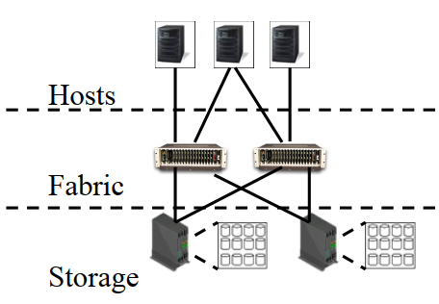
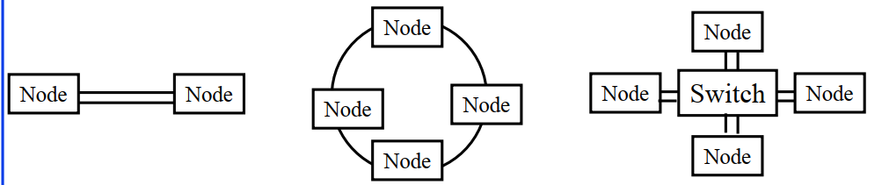
Fibre Chanel
□ ANSI T11 standard for highspeed storage area network (SAN)
□ 2, 4, 8, 16, 32 GBps. Can run on TP or fiber
□ Allows point-to-point,
arbitrated loop (ring), switched fabric topologies
8

Slide 9
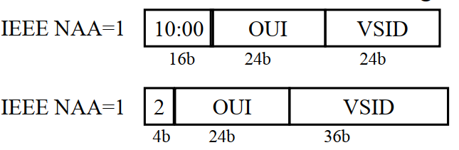
Fibre Channel (Cont)
□ FC host bus adapters (HBA) have a unique 64-bit WorldWide Name (WWN) similar to 48-bit Ethernet MAC addresses with OUI, and vendor specific identifiers (VSID), e.g., 20000000C8328FE6
□ Several different network addressing authorities (NAA)
9

Slide 10
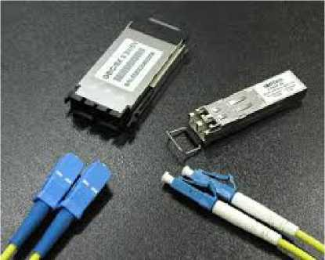
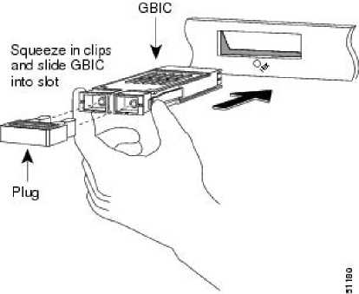
Fibre Channel Devices
□
□
□
□
□
Host Bus Adapters (HBA): Network interface card.
Gigabit Interface Converter (GBIC):
Single mode fiber for long-distance. Multimode fiber for short distance.
HBA ports are empty. Plug in GBIC.
Hubs: Physical layer Device. Like a active patch panel. Multiple hosts or storage devices. Only one host can talk to one device at a time using an arbitrated loop (FC-AL) protocol.
Switches: A link layer device. Forwards FC frames according to destination address.
Routers and Gateways:
Connect FC to other types of storage (SCSI)
Source: Softel-optic
10

Slide 11
Fibre Channel Protocol Layers
SCSI | IP | Single Byte Command Code Sets (SBCCS)
FC Protocol for SCSI (SCSI-FCP) | IPv4 Over FC (IPv4FC) | FC Single Byte Command (FC-SB)
FC Generic Services (FC-GS)
FC Framing and Signaling Interface (FC-PH) | FC Arbitrated FC Switch Fabric Loop (FC-AL) (FC-SW)
 | FC Framing and Signaling (FC-FS)
 | FC-Physical Interface (FC-PI)
Upper Layer Protocols
FC-4: Protocol Mapping
FC-3: RAID, Encryption
FC-2: Network Layer
FC-1: Encoding FC-0: Cables, Connectors
□ New extensions are named by adding a number, e.g., FC-SW-3 extends FC-SW-2, which extended FC-SW
□ Fibre Channel Shortest Path (FSPF) protocol is used to find routes through the fabric. It is a link-state protocol.
□ Vendor specific equal cost path multiplexing
11

Slide 12
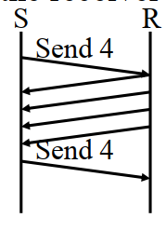
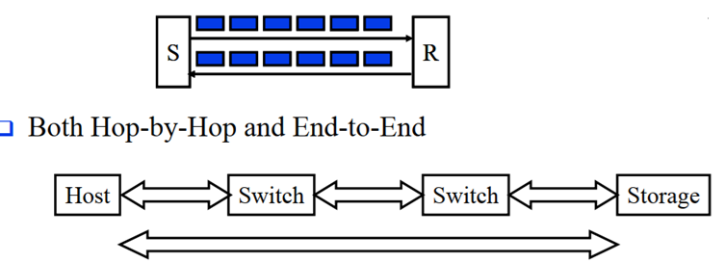
Fibre Channel Flow Control
□ Transmitter sends frames only when allowed by the receiver
□ Credit-based flow control
□ For optimal performance, the Credit >=Round-trip path delay
12

Slide 13
Fibre Channel Classes of Service
□ Class 1: Connection-oriented dedicated (physical links). Frame order guaranteed. Delivery confirmation. End-to-end flow control.
□ Class 2: Connectionless. Multiple paths ^ order not guaranteed. Hop-by-hop and end-to-end flow control.
□ Class 3: Datagram service. No delivery confirmation. Only hop-by-hop flow control. Most common.
□ Class 4: Connection-oriented virtual circuits (fractional links) with delivery confirmation
□ Class 5: Not yet defined
□ Class 6: Connection-oriented multicast with delivery confirmation
□ Class F: Packet-switched delivery with confirmation. For interswitch communication
13

Slide 14
What is Storage Virtualization?
□ Restating Rick F. Van der Lans: Storage virtualization means that Applications can use storage without any concern for where it resides, what the technical interface is, how it has been implemented, which platform it uses, and how much of it is available
□ Distance: Remote storage devices appear local
□ Size: Multiple smaller volume appear as a single large volume
□ Spread: Data is spread over multiple physical disks to improve reliability and performance
□ File System: Windows, Linux, and UNIX all use the same storage device
□ Virtual Interface: A SCSI disk connected to a computer with no SCSI interface
□ Advantages: High availability, Disaster recovery, improved performance, sharing (better CapEx)
14

Slide 15
Benefits of Storage Virtualization
□ Much larger distances
□ Greater performance
□ Increased disk utilization
□ Higher availability with multiple access path
□ Higher availability due to redundant storage
□ Disaster recovery capability
□ Continuous on-line back
□ Easier testing
□ Increased scalability
□ Allows thin provisioning (Appears as if there is more disk than physical)
15

Slide 16
Virtualizing Storage
□ Partitions and file systems are “Virtual” views of the storage
□ A disk array can be partitioned into virtual (logical) devices with LUNs, File systems assigned to different tenants
□ Thin Provisioning: Allocate blocks only when used ^ Overbooking
□ Another way to virtualize storage is use multiple physical disks to look like a single disk using RAID
□ RAID (Redundant array of independent disks)
□ Originally Redundant array of inexpensive disks (as invented by Patterson, Gibson, and Katz)
□ Trick: Divide and replicate data among multiple drives
□ Provides availability, performance and/or capacity.
16

Slide 17
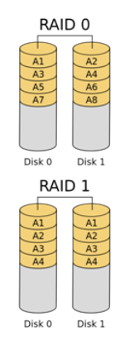
RAID Levels
□ RAID 0: block-level striping without parity. Zero redundancy. Higher performance and capacity.
□ RAID 1: Mirroring without parity. Higher read performance. Two or more mirrors.
□ RAID 2: Bit-level striping with dedicated Hamming code parity. Each sequential bit is on a different drive.
Not used in practice.
□ RAID 3: Byte-level striping with dedicated Hamming code parity. Not commonly used.
17

Slide 18
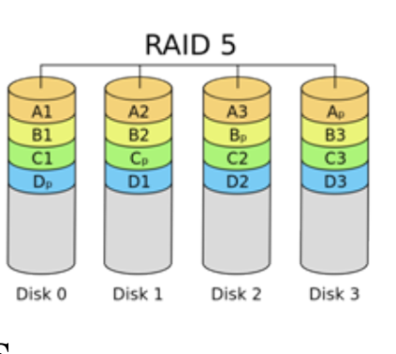
RAID Levels (Cont)
□ RAID 4: Block-level striping with dedicated parity. Allows I/O requests to be performed in parallel.
□ RAID 5: Block-level striping with distributed parity. Masks failure of 1 drive.
□ RAID 6: Block-level striping with double
distributed parity. Masks up to two failed drives. Better for large drives that take long time to recover.
18

Slide 19
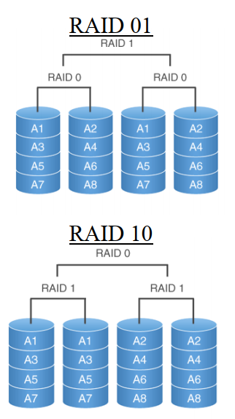
Nested RAIDs
□ RAID of RAID drives
□ RAID 01: Stripe and then mirror = RAID 0+1
Data is striped across primary disks that are mirrored to secondary disks.
□ RAID 10: Mirror then stripe = RAID 1+0
□ The order of digits is the order in which the set is built.
RAID 0+1 ^ Stripping first and then mirroring
□ Mirrored striped set with distributed parity = RAID 5+3 or RAID 53
19

Slide 20
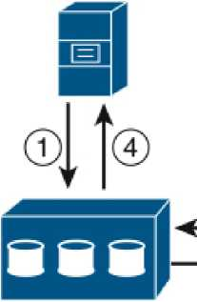



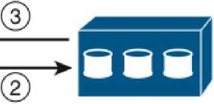
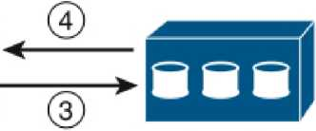

Synchronous vs. Asynchronous Replication
□ Synchronous: Immediate secondary writes.
Write completes only after finishing on secondary storage ^ Guaranteed recovery but slow
□ Asynchronous: Delayed secondary writes
Writes acked to server even before completion on secondary. Writes to secondary are queued in the primary
Synchronous
Replication
Asynchronous
Replication
Primary Array
Secondary
Array
Primary Array
Secondary
20

Slide 21
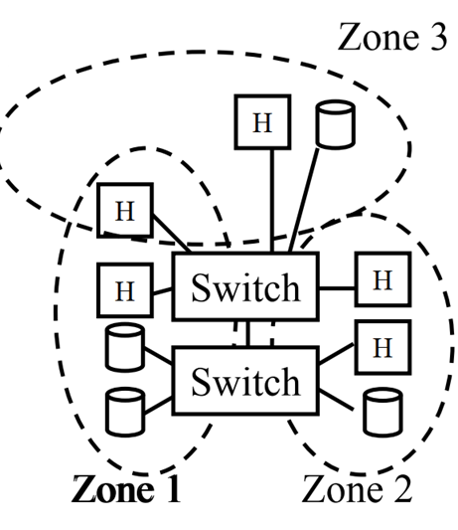
Virtual Storage Area Network (VSAN)
□ Zones in a FC SAN provide isolation
among tenants. Some switch ports can see
only some other switch ports.
□ Different zones share a zone server, name server, and login server Subject to common failures
□ Virtual Storage Area Network (VSAN)
technology allows different partitions with
their own servers. Similar to VLANs.
□ Each VSAN provide complete fabric services Each VSAN can be subdivided in to zones.
21

Slide 22
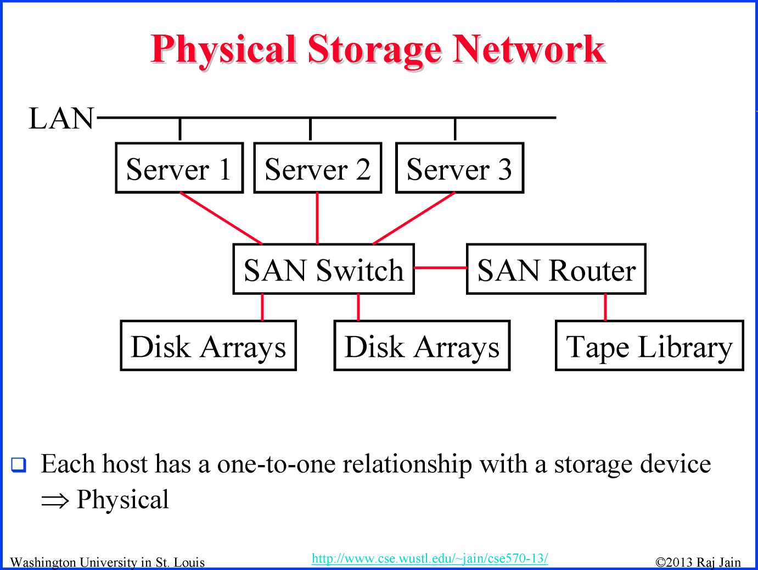
22

Slide 23
Virtual Storage Network
□ In-Band: All control and data goes to virtualization appliance
Server 1 |  | Server 2 |  | Server 3
 | Virtualization Appliance
Disk Arrays Disk Arrays
□ Out-Band: All control goes to Namespace root. Data goes
directly between host and storage
Client
Namespace |  | Windows |  | Unix
Root |  | File Server |  | File Server
23

Slide 24
SAN vs. NAS
□ Storage Area Network (SAN)
Network attached storage (NAS)
□ SAN: Storage servers connected via special purpose storage network, e.g., Fibre Channel
□ NAS: Storage servers accessed over a general purpose network, e.g., Ethernet
24

Slide 25
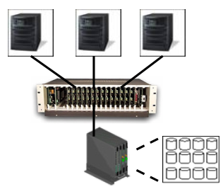
iSCSI (Internet Small Computer System Interface)
□ IETF protocol to carry SCSI commands over traditional TCP/IP/Ethernet
□ Requires no dedicated cabling.
□ Uses TCP end-to-end congestion control
□ Can use the same Ethernet port on the computers to connect to storage devices on different computers
□ iSNS (Internet Storage Name Service) can be used to locate storage resources
25

Slide 26
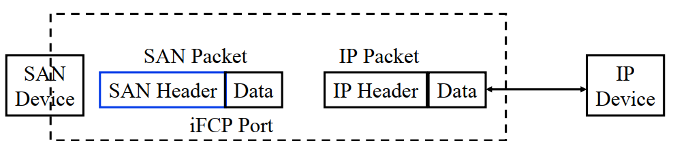
iFCP (Internet Fiber Channel Protocol)
□ Interconnect FC devices using TCP/IP
□ Can connect native IP based storage and FC devices
□ SAN frames are converted to IP packets at the source and sent to the destination
□ Uses TCP Congestion Control (end-to-end)
□ IP to iFCP
26

Slide 27
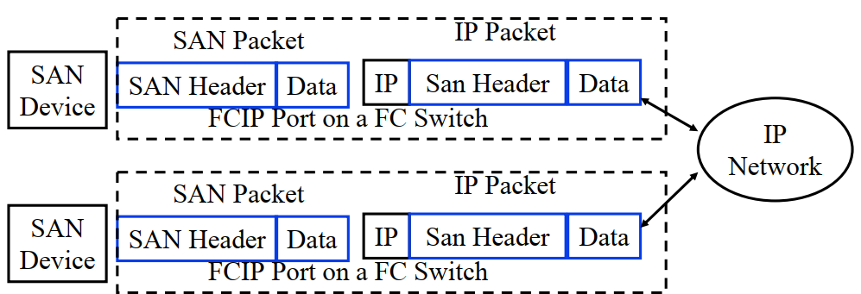
FCIP (Fibre Channel over IP)
□ Tunneling protocol for passing FC frames over TCP/IP.
□ SAN packets are encapsulated in IP packets at the source and decapsulated back at the destination
□ Doesn't allow to directly interface with a FC device.
□ Some FC switches have FCIP ports.
27

Slide 28
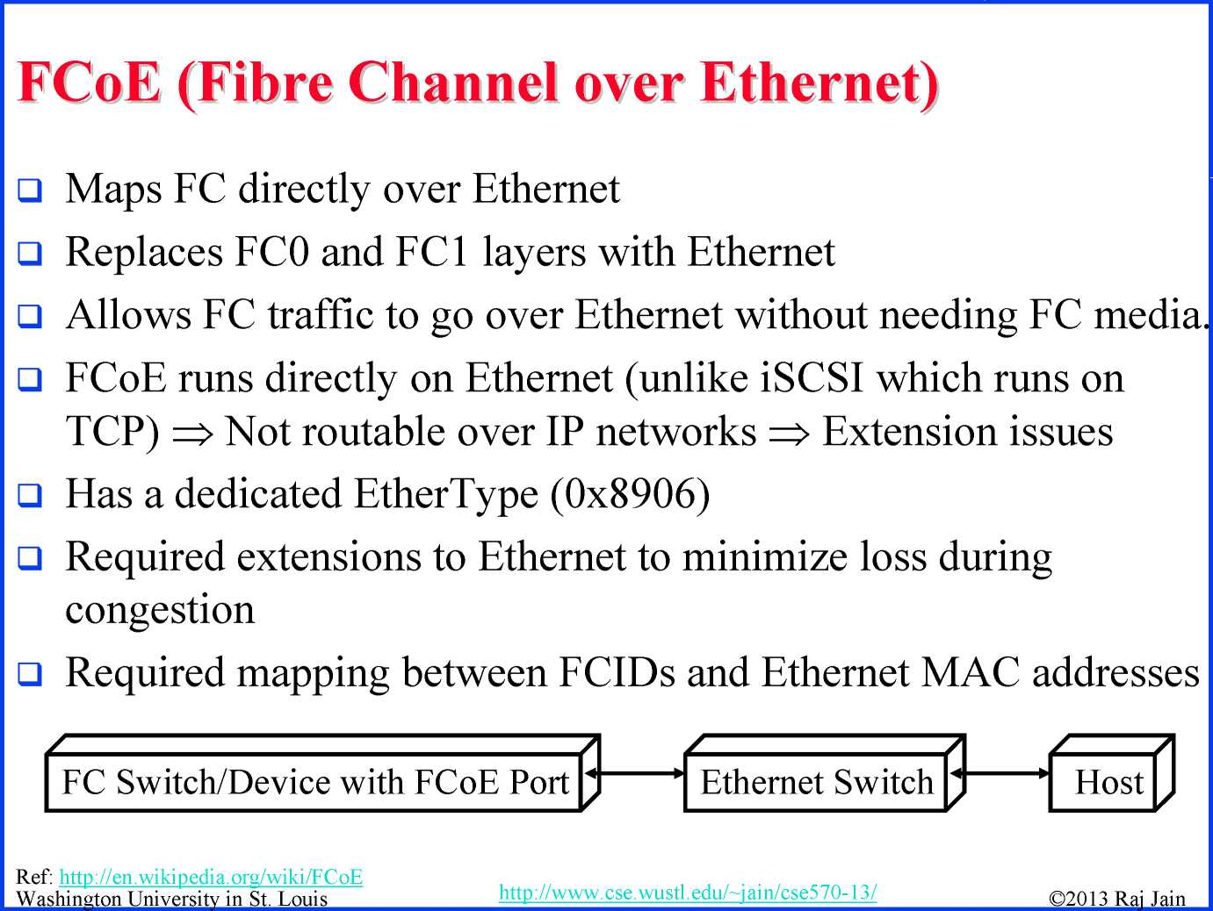
28

Slide 29
Virtual File Systems
□ Storage access is either block based or file based
□ File systems, e.g., NTFS or FAT32 store files on a block based storage.
□ Virtual file systems allows files located on multiple network drives to appear as if on a single local drive
Network drives can be replicated, relocated, reconstructed
□ Windows DFS
□ Linux DFS: Open source implementation of Windows DFS on Linux
□ AFS: Andrew File System from CMU (Andrew Carnegie)
□ Parallel Virtual File System (PVFS) distributes data across multiple servers to provide concurrent access for parallel task
39

Slide 30

1. SCSI is a common interface used on storage devices
2. Fibre channel is a storage area network
3. RAID allows data to be partitioned over multiple drives for performance and fault tolerance
4. iSCSI, iFCP, FCIP, FCoE are protocols for interconnecting storage over Ethernet/IP.
5. SAN is FC based. NAS is Ethernet based.
6. Virtual file systems allow files to be accessed in multiple views from the same storage system.
30

Slide 31
Acronyms
□ | AFS
□ | ATA
□ | ATAPI
□ | ANSI
□ | CapEx
□ | CMU
□ | DFS
□ | EIDE
□ | eSATA
□ | FAT
□ | FC
□ | FC-AL
□ | FC-FS
□ | FC-GS
□ | FC-PH
□ | FC-PI
Andrew File System
Advanced Technology Attachment
Advanced Technology Attachment Programming Interface
American National Standards Institute
Capital Expenditure
Carnegie Mellon University
Distributed File System
Enhanced Integrated Device Electronics
External Serial Advanced Technology Interface
File Allocation Table
Fibre Channel
Fibre Channel Arbitrated Loop
Fibre Chanel Framing and Signaling
Fibre Chanel generic services
Fibre Chanel Framing and signaling interface
Fibre Chanel physical Interface
31

Slide 32
 | Acronyms (Cont)
□ FC-SB | Fibre Chanel Single Byte Command
□ FC-SW | Fibre Chanel Switch Fabric
□ FC-PI | Fibre Chanel physical
□ FCID | Fibre Channel Identifier
□ FCIP | Fibre Channel over IP
□ FCoE | Fibre Channel over Ethernet
□ FSPF | Fibre Channel Shortest Path
□ GBIC | Gigabit Interface Converter
□ HBA | Host Bus Adapters
□ IDE | Integrated Device Electronics
□ IETF | Internet Engineering Task Force
□ iFCP | Internet Fibre Channel Protocol
□ IPv4FC | IPv4 over Fibre Channel
□ iSCSI | Internet Small Computer System Interface
□ iSNS | Internet Storage Name Service
□ JDBC | Java DataBase Connectivity
32

Slide 33
 | Acronyms (Cont)
□ LB | Logical Block
□ LBA | Logical Block Address
□ LUN | Logical Unit Number
□ MAC | Media Access Control
□ mSATA | Mini Serial Advanced Technology Interface
□ NAS | Network attached storage
□ NTFS | New Technology File System
□ ODBC | Open DataBase Connectivity
□ OS | Operating System
□ OUI | Organizationally Unique Identifier
□ PATA | Parallel Advanced Technology Attachment
□ PHY | Physical Layer
□ RAID | Redundant Array of Independent Disks
□ SAN | Storage Area Network
□ SATA | Serial Advanced Technology Interface
□ SBCCS | Single Byte Command Code Sets
33

Slide 34
Acronyms (Cont)
□ | SCSI | Small Computer System Interface
□ | SCSI-FCP | SCSI over Fibre Channel Protocol
□ | SQL | Structured Query Language
□ | TP | Twisted Pair
□ | VLANs | Virtual Local Area Network
□ | VSAN | Virtual Storage Area Network
□ | WWN | World-Wide Name
34

